Slide 1

Automatic Measurement System for Cargo Volume
Oral Defense
Sponsor: Panasonic Mentor: Zhuosi Zhang Instructor: Mingjian Li
Presented by Group 17

Slide 2
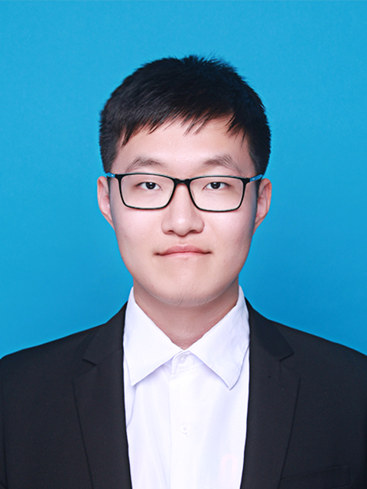
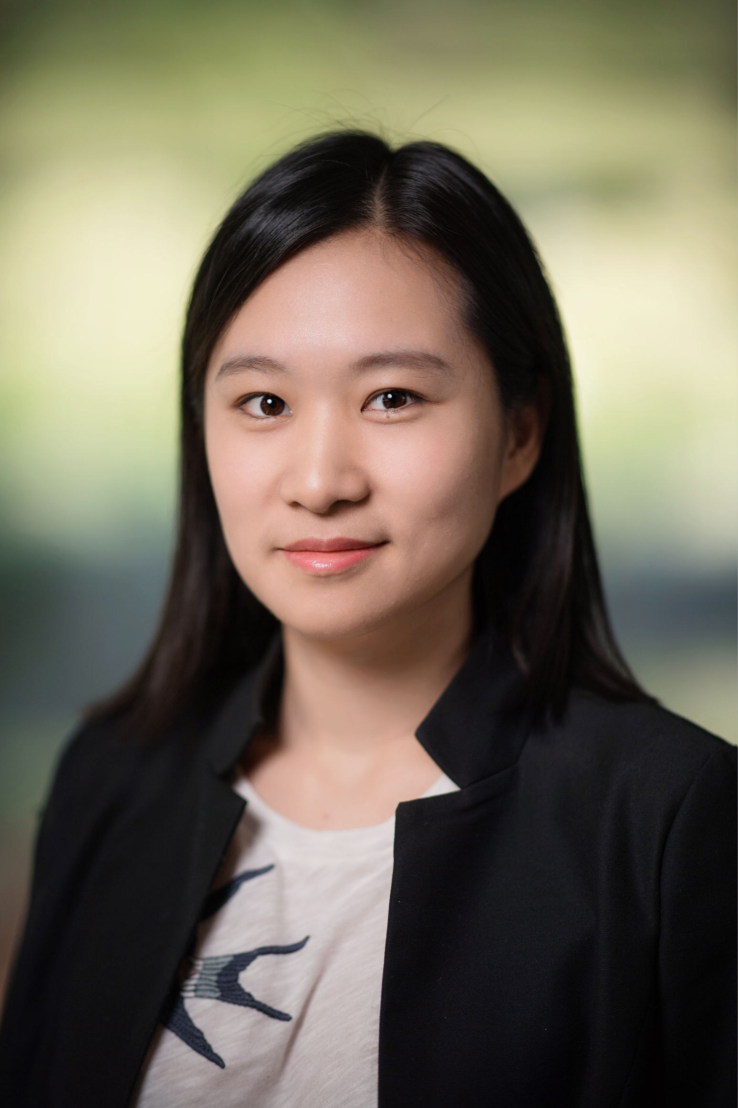
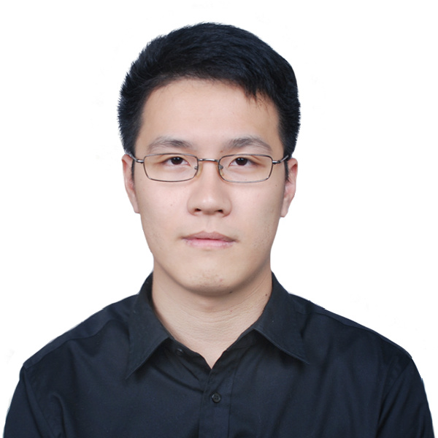
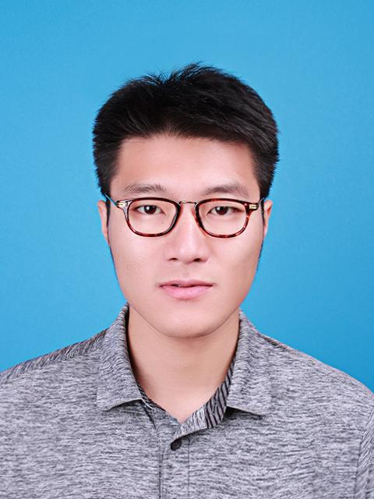

Team Introduction
Team Members:
Zesen Wang (Leader)
JI ECE + KTH ML
Xinyi Wu
JI ECE + UM DS
Yier Zhang
JI ECE + UM EE
Yetong Zhang
JI ME + UM CE
Zitao Zhang
JI ECE + KTH ML

Slide 3
Introduction
Motivation: The growing e-market in China results in the expanding demand of cargo delivery. Delivery companies have demands on:
Fast packing and loading process
Efficient usage of vehicle capacity
Accurate freight calculation

Slide 4
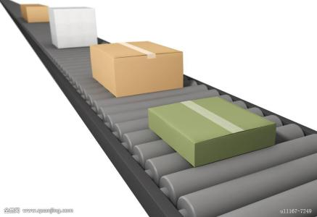
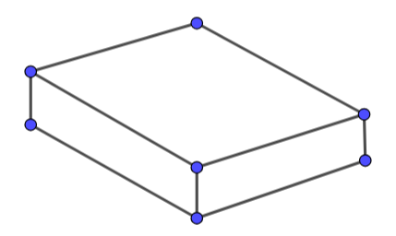
Customer Requirements
Projective:
Accurate measurement of the volume of goods on a conveyor belt
Automatic running
Standardized measurement process
Easy to build, install and use
Low-cost
Expected outcome:
Volume of the cargo
3-D model map of the cargo
Image Referenece: https://ss0.bdstatic.com/70cFuHSh_Q1YnxGkpoWK1HF6hhy/it/u=3831402330,1049417822&fm=200&gp=0.jpg

Slide 5
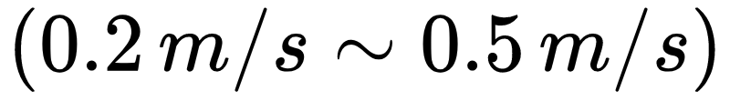
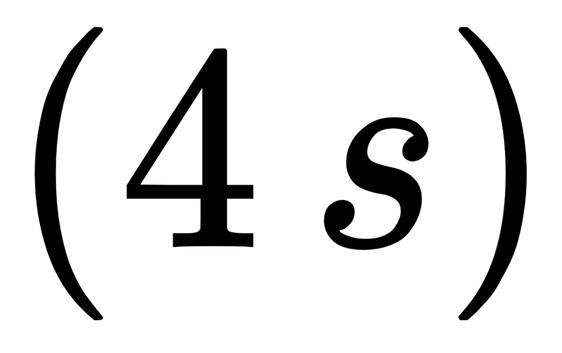
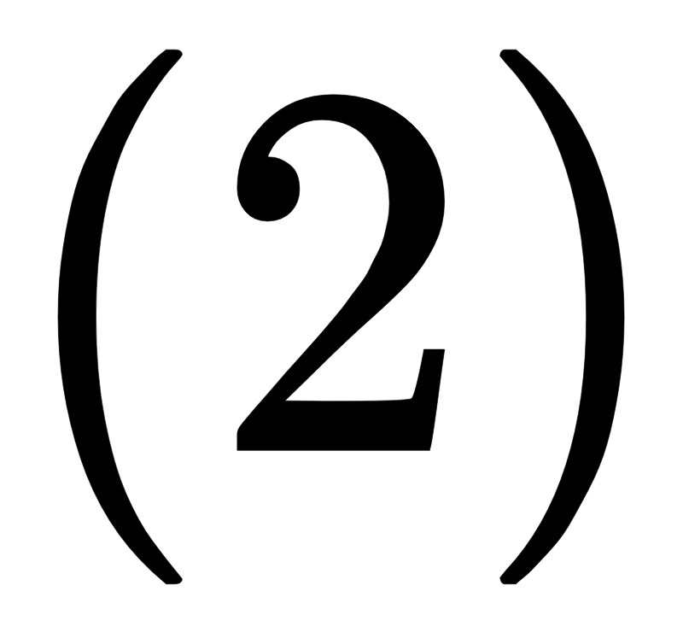
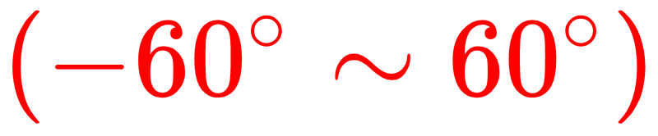
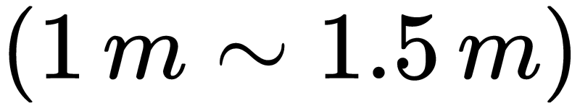
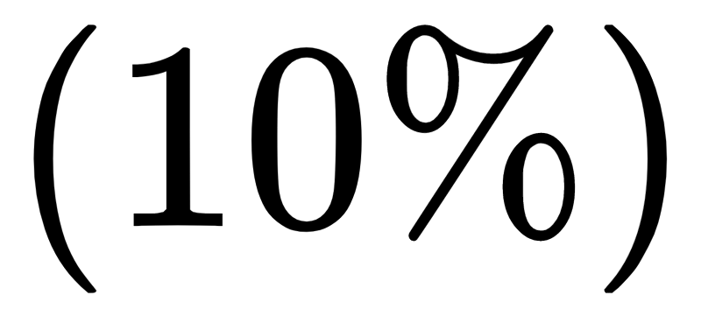
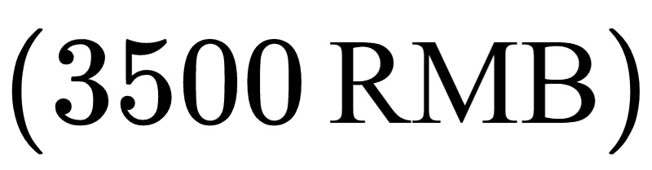
Engineering Specification
Background
Speed of conveyor belt
Cargo size range
Processing time
Design Detail
Number of depth cameras
Filming angle range
Camera distance
Technical Objective
Max unilateral error
Cost restriction

Slide 6
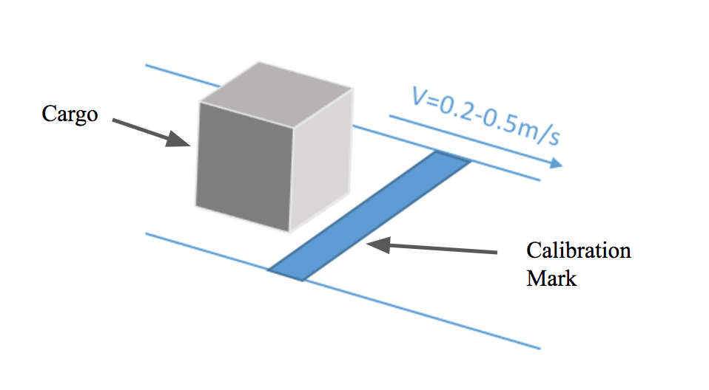
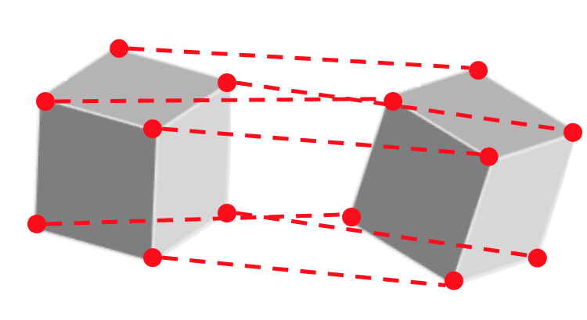
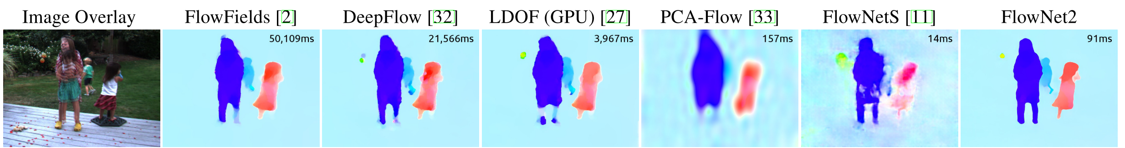
Concept Generation
Alignment Algorithm
Corner alignment
Use calibration markers
Iterative Closest Point (ICP)
Principal Component Analysis (PCA)
Random Sample Consensus (RANSAC)
https://arxiv.org/abs/1612.01925
Classical alignment method
Optical flow estimation

Slide 7
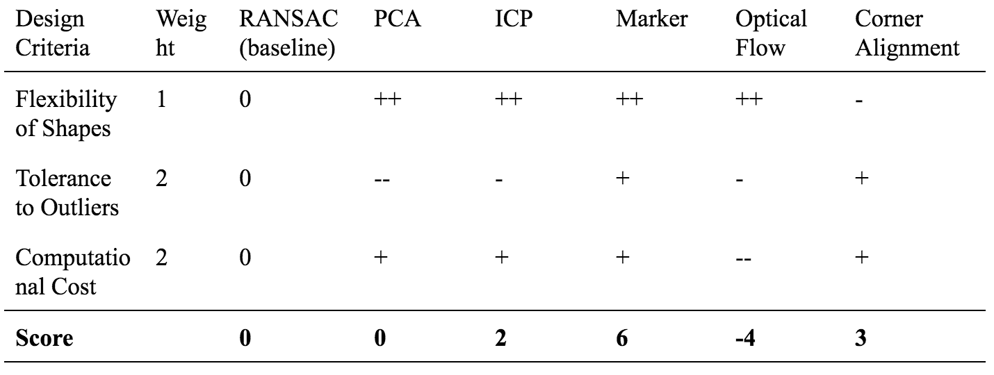
Concept Selection
Alignment Algorithm

Slide 8
Concept Selection
Alignment Algorithm

Slide 9
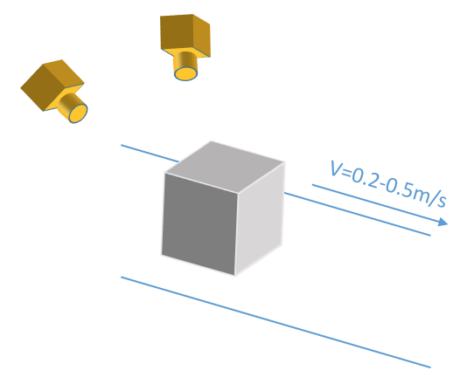
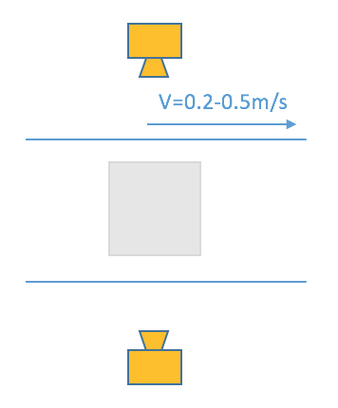
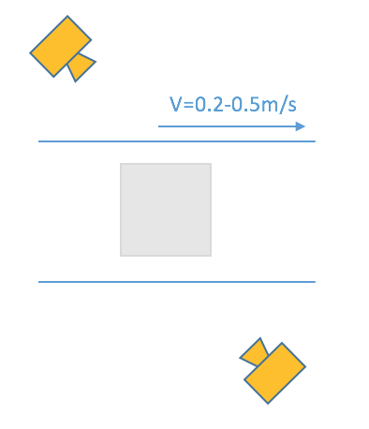
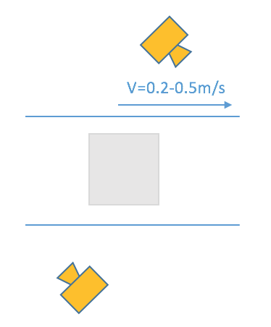
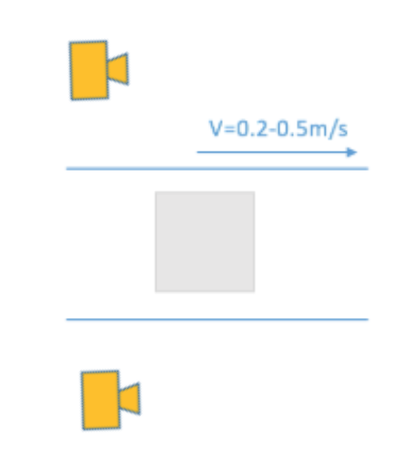
Concept Generation
Camera Placement
Left to right: 90°, 45°, 45° staggered, 0°

Slide 10
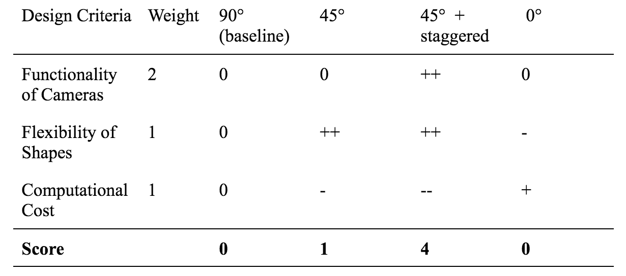
Concept Selection
Camera Placement

Slide 11
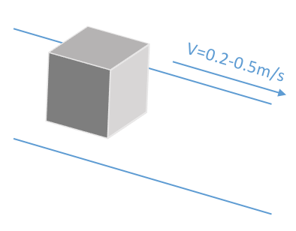
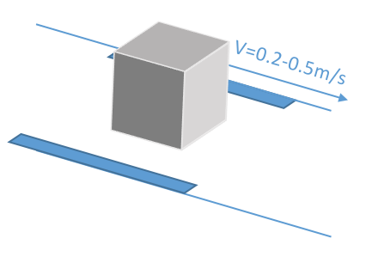
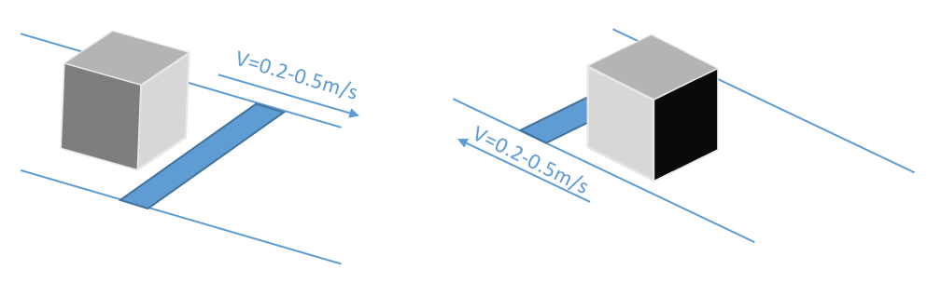
Concept Generation
Marker Placement
Left to right: no reflective tape, sides, front

Slide 12
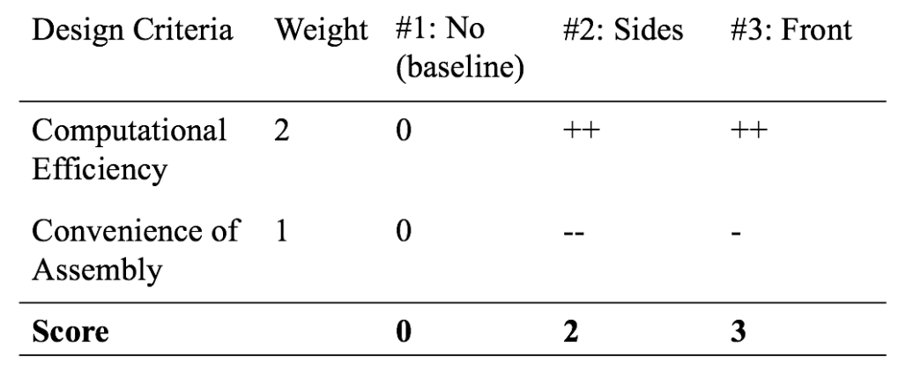
Concept Selection
Marker Placement

Slide 13
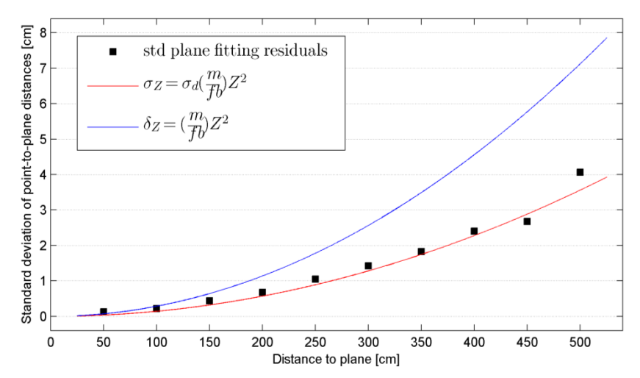
Parameter Analysis
Parameter: Camera height
larger distance⇒ higher error

Slide 14
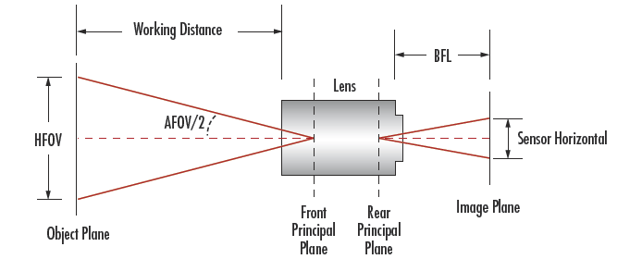
Parameter Analysis
FOV: field of view
WD: working distance
h: size of image
f: focal length of camera
L: side length of cargo
FOV = WD・h / f
WD = SF・L・f / h + L

Slide 15
Parameter Analysis
=1.5
FOV: field of view
WD: working distance
h: size of image
f: focal length of camera
L: side length of cargo
FOV = WD・h / f
WD = SF・L・f / h + L
⇒ height = 1.2m

Slide 16
Final Design
Two depth cameras -> Depth images and IR images
Reflection tape -> Locating the cargo
Extract point clouds from depth images
Align and combine point clouds from one camera
Combine point clouds from two cameras

Slide 17
Functional Decomposition
Mechanical Structures:
Conveyor belt & reflection tape
Cameras & supports
Software Parts:
Point cloud generation & background elimination
Cargo detection
Coordinate conversion & point cloud alignment
Volume estimation
3-D model output

Slide 18
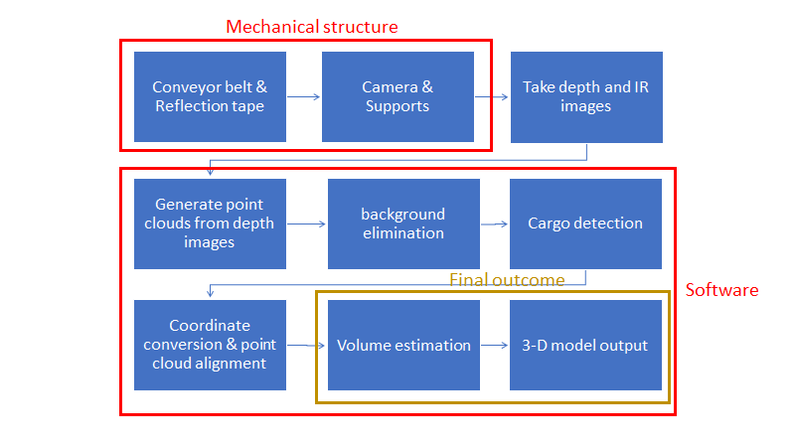
Function Flow Chart

Slide 19
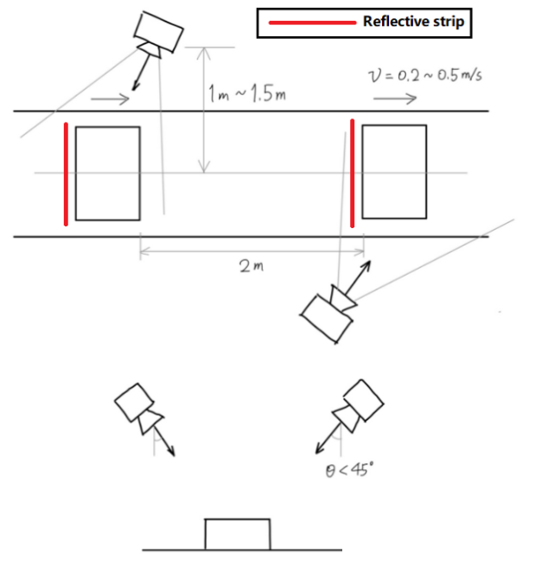
Chosen Concept
Top view
Side view

Slide 20
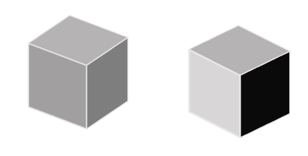
Design - Camera Positions

Slide 21
Design - Reflection Tape

Slide 22
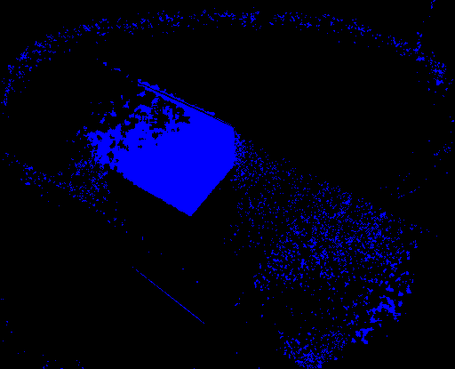
Design - Background Elimination
Subtraction Method
Subtracting the static background image, the cargo object becomes distinguishable

Slide 23
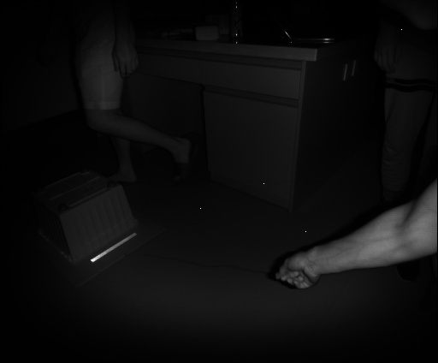
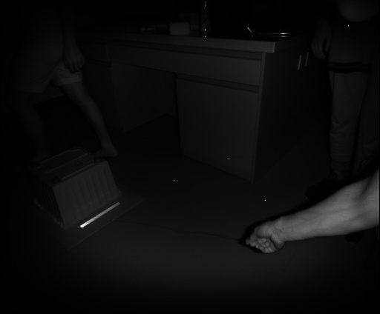
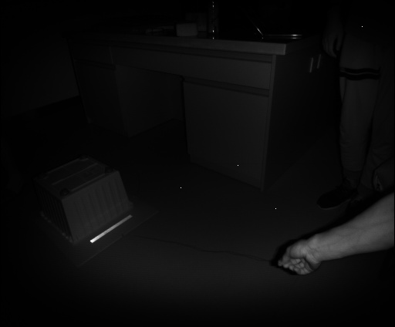
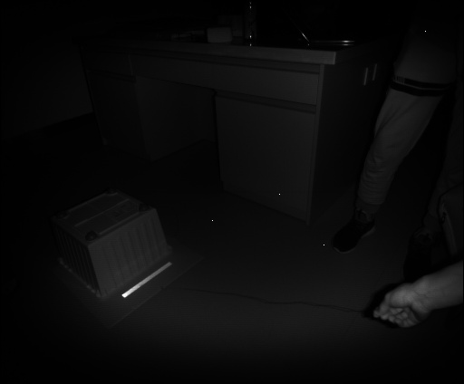
Design - Alignment Method
Same camera,
multiple views

Slide 24
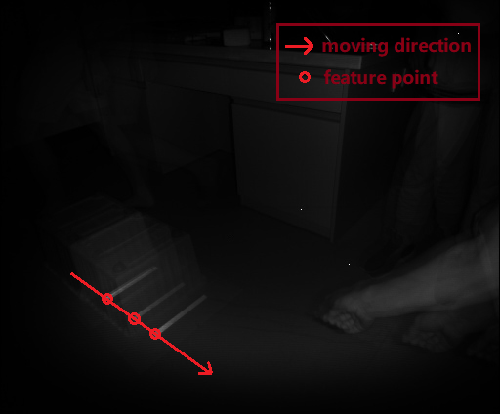
Design - Alignment Method
Same camera,
multiple views

Slide 25
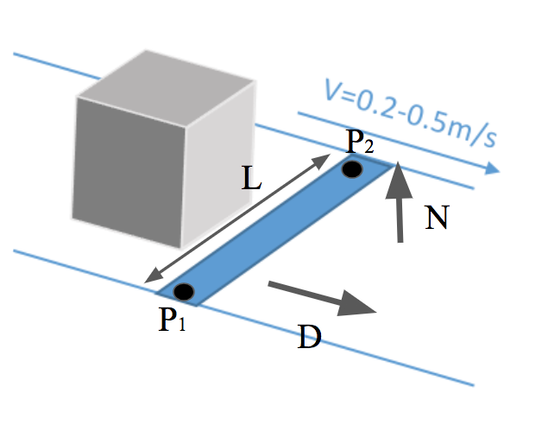
Design - Alignment Method
Different cameras
Use feature points to locate.
Rotate, shift and combine the final point clouds.
P2=P1+L•N×D
L: length of reflective tape
D: Unit vector in the moving direction of the belt
N: Normal vector to the surface of the belt
P1, P2: End points of reflective tape

Slide 26
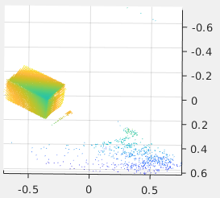
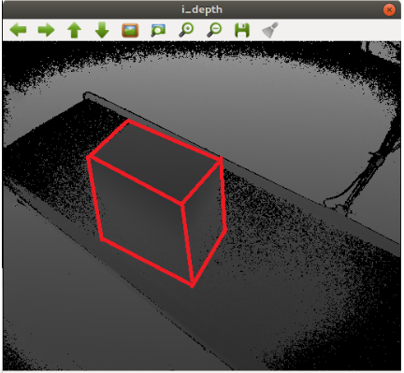
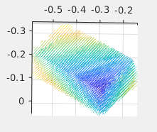
Design - Denoising

Slide 27
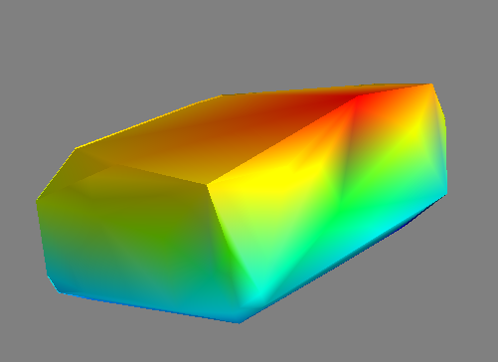
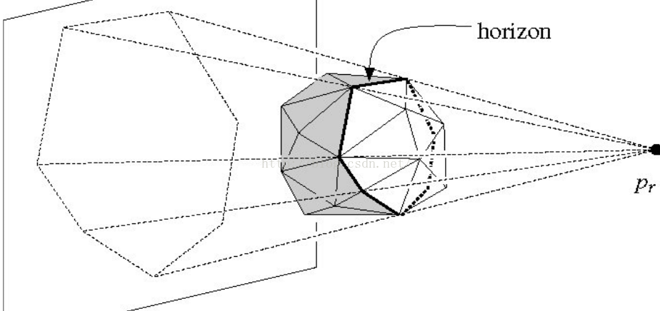
Design - Convex Hull Construction
Random Incremental Algorithm
https://blog.csdn.net/theArcticOcean/article/details/50646428

Slide 28
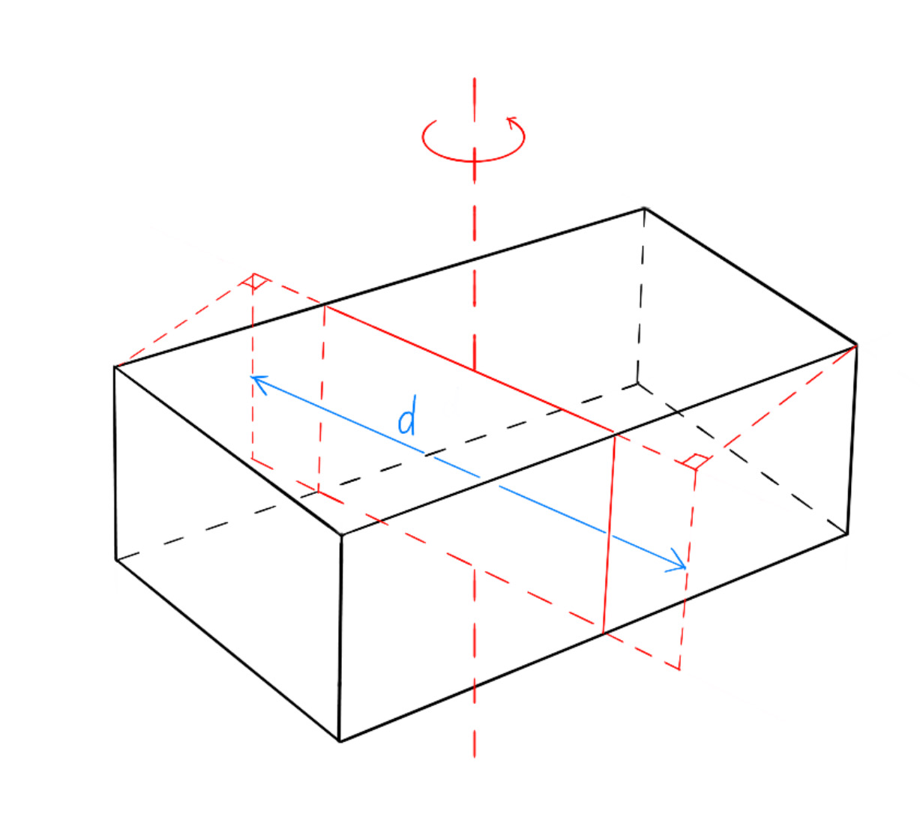
Design - Volume Estimation
Shape Detection - Length & width Recognition
Choose the Axis pass through the center of weight
Get the length d among the cross section
Rotate the cross section to get a couple of d s
The width vector is on the surface of cross section with minimum d
Get the length vector which is perpendicular to width

Slide 29
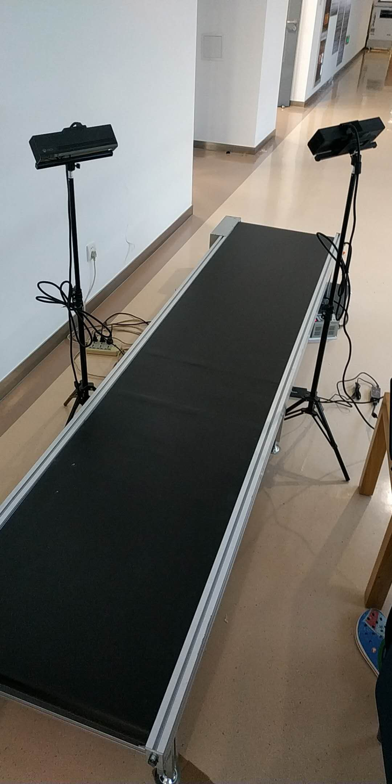
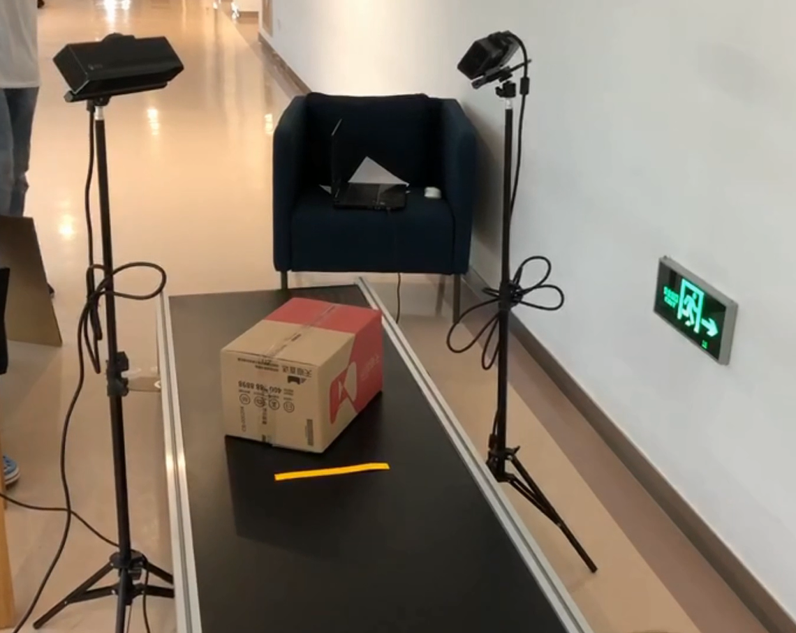
Prototype Discription
Mechanical Part:

Slide 30
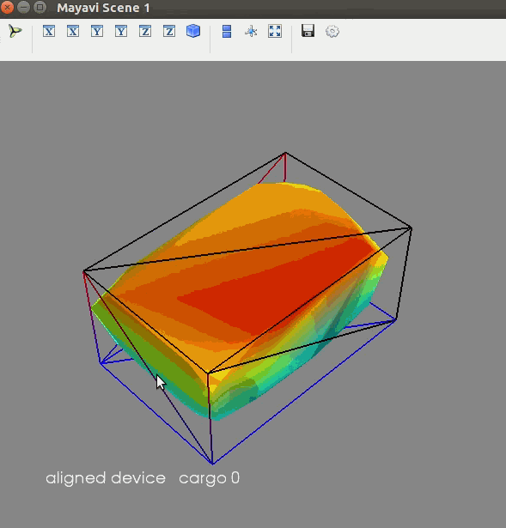
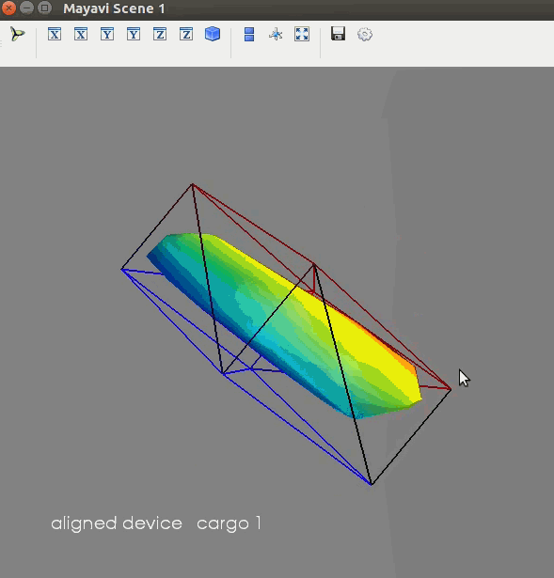
Prototype Discription
Output Model:

Slide 31
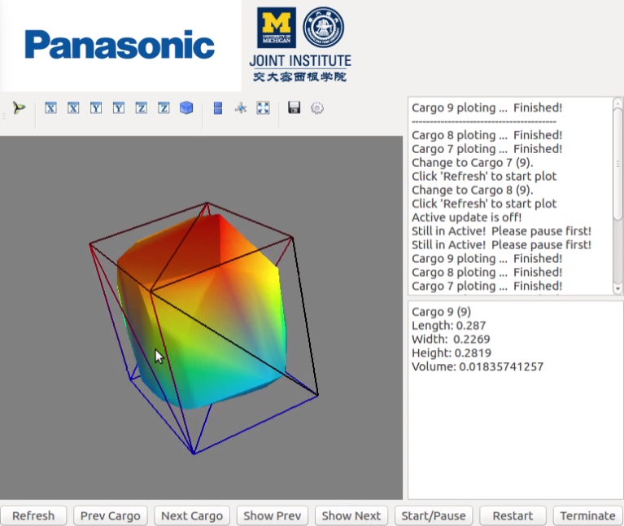
Prototype Description
GUI Demo

Slide 32

Prototype Description
GUI Demo:
Real-time update

Slide 33

Prototype Discription
GUI Demo:
Real-time update
Functions

Slide 34

Test Results
3 objects of varying sizes
2 conveyor speeds
20 tests for each object under each speed
different orientations and locations
record execution time and unilateral error

Slide 35

Test Results
Notes:
We used three boxes with different sizes for our test and conducted 20 tests for each object with the conveyor belt moving at 0.3m/s and 0.4m/s respectively. We placed the object at different locations and orientations on the conveyor belt

Slide 36
Discussion
Achievements
Practical system with low cost
Estimate size and shape accurately of specified cargos
Execute in real-time
Oversights
Limitation on distance between consecutive objects
Not robust to dynamic background
Slight offset in point cloud alignment

Slide 37
Conclusion
We have successfully designed an automatic cargo volume estimation system.
Our design with Kinect cameras is compact and has lower cost compared to existing products.
Our system can estimate the size and shape of cargos ranging from 10*10*10cm3 to 40*40*40cm3 in real time.
The unilateral error of the size measurement is within 10%.

Slide 38
Reference
[1] Newcombe, Richard A., et al. "KinectFusion: Real-time dense surface mapping and tracking." Mixed and augmented reality (ISMAR), 2011 10th IEEE international symposium on. IEEE, 2011.
[2] J. Loera, J. Rambau and F. Santos (2010), Triangulations: Structures and Algorithms (2nd revised ed.), Springer-Verlag, ISBN 9783642129711 Chapter 3: Polygon Triangulation: pp.103.
[3] Besl, Paul J.; N.D. McKay (1992). "A Method for Registration of 3-D Shapes". IEEE Trans. on Pattern Analysis and Machine Intelligence. Los Alamitos, CA, USA: IEEE Computer Society. 14 (2): 239–256. doi:10.1109/34.121791
[4] Pirovano, Michele. "Kinfu–an open source implementation of Kinect Fusion+ case study: implementing a 3D scanner with PCL." no. October 2012 (2011).
[5] Kakinoki, Yoshikazu, Masato Nakashima, Tetsuo Koezuka, Noriyuki Hiraoka, Hiroyuki Tsukahara, Yoshinori Suto, Yoshitaka Oshima, and Shinji Hashinami. Optical System for Detecting Three-dimensional Shape. Fujitsu Ltd, assignee. Patent US5004929A. 2 Apr. 1991. Print.
[6] Itsuzaki, YasuoYoshihiro, Masatoshi Nakamura, Noriyuki Suzuki, Misuzu Takano, and Kinji Horikami. Shape Detection Apparatus. Panasonic Corp, assignee. Patent US5995663A. 30 Nov. 1999. Print.
[7] Nakagawa, Yasuo, and Shree Nayer. Method of Detecting Solid Shape of Object with Autofocusing and Image Detection at Each Focus Level. Hitachi Ltd, assignee. Patent US5151609A. 29 Sept. 1992. Print.
[8]. Specification for “Heavy Duty Slider Bed Conveyor - Model TL 42" OAW, 17'-1" long”,
Hytrol Conveyor Company, Inc. http://www.cisco-eagle.com/catalog/product/12410/
heavy-duty- slider-bed-conveyor-model-tl-42-oaw-17-1-long
[9]. “Kinect for Windows Sensor Components and Specifications” https://msdn.microsoft.com/en-us/library/jj131033.aspx
[10]. K. Khoshelham, S.O. Elberink, “Accuracy and resolution of Kinect depth data for indoor mapping applications”, Sensors, 12:1437–1454, 2012.
[11]. Li, Lingling, Z. Wang, L. Qing, and H. He, “Fast Volume measurement based on Kinect 2.0 depth image”, Microcomputer & Its Applications, vol. 1, no. 7, 2017, pp. 35-38.
[12]. Dellen, Babette, I. Rojas, “Volume measurement with a consumer depth camera based on
structured infrared light”, 16th Catalan Conference on Artificial Intelligence, poster session, 2013, Vic, Spain, pp. 1-10, ACIA.

Slide 39
Presented by Group 17

Slide 40


Speed of Conveyor Belt
Heavy Duty Slider Bed Conveyor - Model TL 42" OAW, 17'-1" long
=0.33m/s

Slide 41
Processing Time
2 meters space between two goods
0.5 m/s maximum speed
T_min = 2 / 0.5 = 4s

Slide 42
Cost Restriction
Kinect 2.0 x 2 1488 * 2 = 2976RMB
Camera Support x 2 30 * 2 = 60RMB
Light Reflection Tape 10RMB/m * 20 m = 200RMB

Slide 43

Max Unilateral Error
errors increase quadratically with camera distance
About 0.5 cm deviation at 1.5 m distance
Max unilateral error = 0.5cm/5cm = 10%
“Kinect for Windows Sensor Components and Specifications” https://msdn.microsoft.com/en-us/library/jj131033.aspx

Slide 44

Quality Function Development
-45~45
1~1.5

Slide 45

Quality Function Development
-60~60
1~1.5

